Slide 1
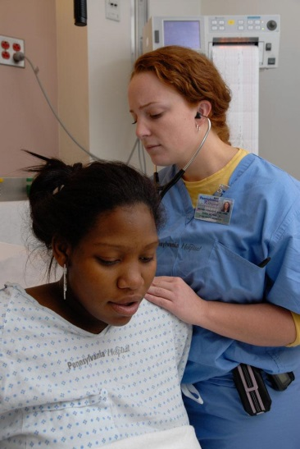
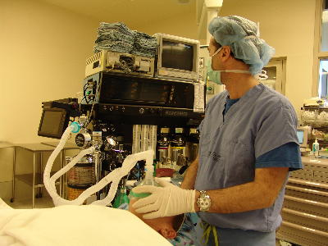
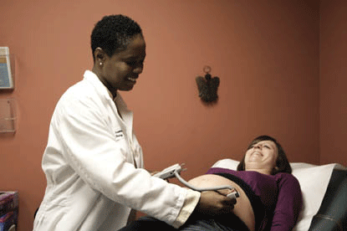
MN Graduate Nursing Education & Clinical Training
Mary Chesney, PhD, RN, CPNP
Clinical Associate Professor & Director,
Doctor of Nursing Practice Program
University of Minnesota School of Nursing
Immediate Past President, MN APRN Coalition

Slide 2
Presentation’s Definition of GNE
GNE = graduate nursing education in the generic sense & doesn’t relate to a formal funding mechanism
Differentiated from GME (Graduate Medical Education) – a formal Medicare-sponsored funding mechanism for graduate medical education
NOTE: ACA mandated pilot GNE funding grant
5 U.S. Hospitals (and affiliated APRN programs)
First time in 47 years Medicare is supporting APRN education
Notes:
Duke U Hospital
Memorial-Hermann TX Medical Center – Houston
Rush U Medical Center –Chicago IL
Scottsdale Health Center – AZ
U Penn Hospital - Philadelphia

Slide 3
GNE Categories by Nurse Role
Traditional Advanced Practice Registered Nurse (APRN)
Clinical Nurse Specialists (CNSs)
Nurse Midwives (NMs)
Nurse Practitioners (NPs)
Registered Nurse Anesthetists (RNAs)
Programs other than APRN
Nursing administration/leadership
Nursing Education
Informatics
Public Health
Integrated Health & Healing

Slide 4
GNE Categories by Degree
GNE continues to evolve; moving from Master’s to Doctoral degree preparation
Prerequisite for admission to either degree is a minimum of a bachelor’s degree in nursing
Master’s Degree
2 years
Doctor of Nursing Practice (DNP) Degree
Initiated in 2006
3 to 4 years (about 8 -9 semesters)

Slide 5
APRN Acronym Key
A/GNP Adult/Gerontology Nurse Practitioner
A/GCNS Adult/Gerontology Clinical Nurse Specialist
FNP Family Nurse Practitioner
RNA Registered Nurse Anesthetist
NM Nurse Midwife
PCNS Pediatric Clinical Nurse Specialist
PMHNP Psych-Mental Health Nurse Practitioner
PNP Pediatric Nurse Practitioner
WHNP Women’s Health Nurse Practitioner

Slide 6
Minnesota’s Graduate APRN Programs
Augsburg – FNP (DNP degree)
Bethel – NM (MS degree)
College of St. Scholastica – ACNS, A/GNP, FNP, PMHNP (DNP degree)
Mayo School of Health Sciences – RNA (MNAP DNAP)
Metropolitan State University – FNP (DNP degree)
Minneapolis School of Anesthesia/St. Mary’s U – RNA (MS)
MN State University-Mankato – FNP (MS degree)
St. Catherine University – A/GNP, PNP (MS degree); option to earn DNP degree)
University of MN – A/GNP, FNP, PNP, PMHNP, WHNP; RNA, NM, A/GCNS, PCNS (DNP degree)
Winona State University – A/GNP, Acute A/GNP, FNP (MS degree; option to earn DNP degree)
Notes:
10 graduate schools or universities offering graduate APRN programs

Slide 7
MN’s Graduate Primary Care APRN Programs
MN School | A/GNP | FNP | PNP | WHNP | NM
Augsburg College |  | X
Bethel University |  |  |  |  | X
College of St. Scholastica | X | X
Metropolitan State University |  | X
Minnesota State University - Mankato |  | X
St. Catherine University | X |  | X
University of Minnesota | X | X | X | X | X
Winona State University | X | X

Slide 8
MN’s Graduate Acute Care/MH APRN Programs
MN School | Acute Care A/GNP | A/G CNS | Nurse Anesthesia | Peds CNS | Psych MH NP
College of St. Scholastica |  | X |  |  | X
Mayo School of Health Sciences |  |  | X
Minneapolis School of Anesthesia (St. Mary’s) |  |  | X
University of Minnesota |  | X | X | X | X
Winona State University | X | X

Slide 9
MN’s Other Graduate Nursing Programs
MN School | Admin/ Leader | Ed | Integrative Health | Informatics | Public Health | Trans-Cultural Nsg.
Augsburg College |  |  |  |  |  | X
Bethel University | X | X
MN State U - Mankato |  | X
St. Catherine University |  | X
University of Minnesota | X |  | X | X | X
Winona State University | X | X |  | *Certificate (non-degree) Program

Slide 10
MN’s Primary Care APRN Grads 2012-13
School | A/GNP | FNP | NM | PNP | WHNP | Total
Augsburg (15/yr) | - | New 2013 | - | - | - | 0
Mankato | - | 34 | - | - | - | 34
Metro St | - | 24 | - | - | - | 24
St. Catherine |  |  |  |  |  | 99*
St. Scholastica | 16 | 27 | - | - | - | 43
U of MN | 9 | 16 | 6 | 5 | 8 | 44
Winona | 2 | 10 | - | - | - | 12
Totals |  |  |  |  |  | 256
Notes:
St. Kate’s transitioned to a new curricular plan – resulted in 3 cohorts vs. 2 graduating – so number about 40 over normal rate

Slide 11
APRN Requirements for Practice
Role & Pop -Focused Clinical Training Hrs =
500 to 1,000+
State APRN Licensure
(As of January, 2015)
National Board Certification in Role & Specific Population Focus
Graduate Nursing Education – Master’s or DNP Degree
Clinical Practice as an RN
Registered Nurse License
Minimum of Bachelor’s Degree in Nursing
BSN Clinical Training Hrs =
Min. 500+
4 yrs. BSN + 2-3 yrs. MS/DNP =
6+ Years of Academic & Clinical Preparation

Slide 12
APRN Clinical Hours
Determined by a number of entities
Accrediting bodies
Certification bodies
American Association of Colleges of Nursing
National Task Force (NP)
Competency-based components may extend clinical hours
MN Schools
Master’s programs - minimum of 500 hours (MN avg. of 600 hours) 1:1 preceptor-supervised, role and population-focused direct provider clinical hours
DNP programs - minimum 1,000 hours
About 650 to 800+ hours of 1:1 preceptor-supervised, role and population-focused direct provider clinical hours
200 to 400+ hours of systems-focused clinical hours (QI projects, IPECP leadership initiatives)

Slide 13
U.S. & MN APRN Data
U.S. 2014
MN August 2014
APRN Role | # in U.S.
CNSs | 70,000
NMs | 13,071
NPs | 192,000
RNAs | 39,000
TOTAL | 314,071
APRN Role | # in MN
CNSs | 554
NMs | 287
NPs | 3,969
RNAs | 1,647
TOTAL | 6,457

Slide 14
GNE APRN Clinical Training
Clinical training days are integrated into didactic education
Students are assigned to a specific clinical site and preceptor (MD or APRN) for a semester
RNA student is assigned to surgery department & works with a CRNA or MDA
NP student is assigned to an NP or MD/DO at an urban, suburban, or rural clinic)
NM student assigned to NM and practices both in clinic setting and in birthing center or hospital L & D
CNS student assigned to CNS in hospital unit
Variety of rotations planned across time to expose students to racial/ethnic/SES/geographic diversity
Typical full-time student APRN school week:
36 to 40 hours of didactic course work (courses plus homework)
16 hours (two 8-hour days) clinical training

Slide 15
GNE APRN Clinical Training
Other than limited MERC funding to qualifying clinical sites, there isn’t a funding mechanism for APRN clinical training
Preceptors and clinical facilities precept APRN students on a volunteer basis (exception – emergence of preceptor payments from out-of-town online NP programs)
CMS oversight and charting requirements that limit provider productivity cause reluctance to precept APRN students
Requirements are more onerous for staff working with APRN or medical students than those working with residents who are already licensed

Slide 16
Clinical Training Sites
Urban, suburban, rural out-patient clinics (pediatric, internal medicine, family practice, women’s health, OB-Gyn)
Urgent care & retail clinics
Urban, suburban, and rural hospitals (surgical suites, L & D, patient-care units, ED)
Ambulatory surgery centers
Transitional care units, long-term care facilities, and home care agencies

Slide 17
APRN Student Numbers & Sites Needed
U of MN utilizes over 250 clinical sites per semester
180 NP primary care, LTC, or TCU sites
16-20 CNS in-patient sites
10-14 NM sites (clinics and L & D or birth center sites)
36 NA sites

Slide 18
Estimate of MN Needed APRN Sites per Semester
Psych-MH NP sites = 40 to 50 per semester
Primary Care NP sites needed per semester = 400 to 450 per semester
Biggest demands
FNP sites = 235 to 245 per semester (6 FNP programs in MN)
A/GNP sites = 130 to 140 per semester (3 A/GNP programs in MN)
Numerous out-of-state online FNP programs add to these numbers
Nurse midwife sites = 50 per semester
Nurse anesthesia sites = 160 to 165 per semester
Clinical nurse specialist sites = 50 to 60 per semester
TOTAL APRN Clinical Training Sites per Semester = 700 to 775*
(* Missing Winona State’s Acute-Care A/GNP numbers)

Slide 19
Challenges & Issues
No federal funding mechanism for clinical training of APRNs
Onerous CMS regulations for medical and APRN students result in decreased productivity & revenue in current fee-for-service reimbursement structure
Proprietary out-of-state online schools are starting to pay for preceptors/sites; many implications to consider
Increasing Twin Cities & Rochester competition for primary care sites (Med, PA, APRN)

Slide 20
Challenges & Issues
Placing & supporting APRN clinical students in greater MN is currently challenging
As of 2013, there are 28 unfilled faculty vacancies in Minnesota (American Association of Colleges of Nursing, 2014)
Faculty shortages continue to rise; majority of today’s nursing faculty members will retire within the next 10-15 years; we do not have adequate DNP or PhD degree nurses in the pipeline
Nursing faculty salaries are not competitive with practice salaries; disincentive to teach

Slide 21
Challenges & Issues
APRN workforce doesn’t represent MN’s racial/ethnic diversity
Working to recruit students of color; best demographic representation
in nursing currently resides in A.D. nursing programs
Race or Ethnicity | Minnesota (2013)* | MN APRNs (2011-12)**
American Indian | 1.3% | 0.4%
Black or African American | 5.7% | 1.7%
Asian | 4.5% | 1.8%
Multiple Races | 2.3% | 1.2%
Other | 0.1% | 0.8%
White or Caucasian | 86.2% | 94%
Hispanic or Latino | 5.0% | 0.8%
*Data from 2013 U.S. Census
**Data from MDH ORHPC 2011-12

Slide 22
Questions?

